Slide 1




NEXT GEN EMPLOYABILITY PROGRAM
Creating a future-ready workforce
Team Members
College Name
Student Name :D.CELITY DANI
Student ID : 960221243016
ARUNACHALA COLLEGE OF ENGINEERING FOR WOMEN

Slide 2

CAPSTONE PROJECT SHOWCASE
Project Title
Car Rentals Application with Django Framework
Abstract | Problem Statement | Project Overview | Proposed Solution | Technology Used | Modelling & Results | Conclusion

Slide 3
Abstract
This project aims to create a robust car rental application leveraging the Django framework.
The application allows users to browse and book available cars based on their preferences and location.
Key features include user authentication, car inventory management, booking management, payment processing integration, and an intuitive user interface.
By employing Django's MVC architecture and built-in security features, the application ensures scalability, maintainability, and security.
Overall, the project facilitates efficient car rental operations while providing a seamless user experience.
Source :

Slide 4
Problem Statement
This project seeks to tackle the challenge of creating a streamlined and user-friendly car rental application utilizing the Django framework.
The current market lacks robust solutions that seamlessly integrate inventory management, user authentication, booking management, and payment processing while maintaining a clean and intuitive user interface.
By identifying and addressing these pain points, the aim is to deliver a comprehensive solution that enhances the overall car rental experience for both customers and administrators.
Source :

Slide 5
Project Overview
This project involves the development of a sophisticated car rental application using the Django framework. The application will provide a platform for users to browse, select, and book rental cars conveniently.
Key features include user authentication, car inventory management, booking management, payment integration, and an intuitive user interface.
By leveraging Django's MVC architecture and robust features, the aim is to create a scalable, secure, and user-friendly solution that meets the demands of modern car rental businesses.
Source :

Slide 6
Proposed Solution
.
The proposed solution involves building a comprehensive car rental application using the Django framework.
Key components include a user-friendly interface for browsing and booking cars, secure authentication for users and administrators, efficient inventory management, seamless booking management, and integrated payment processing.
Leveraging Django's robust features, such as ORM for database management and built-in security measures, ensures scalability, maintainability, and reliability.
By incorporating these elements, the solution aims to provide a seamless and convenient car rental experience for both customers and rental agencies.
Source :

Slide 7
User Authentication: Implementing secure user authentication to allow customers to create accounts, log in, and manage their profiles.
Car Inventory Management: Developing a robust system for managing the rental car inventory, including adding new cars, updating availability status, and categorizing vehicles based on type, model, and features.
Booking Management: Creating a seamless booking system that enables users to search for available cars based on their preferences, select rental dates, and complete bookings with ease. The system will also handle reservation conflicts and cancellations effectively.
Payment Integration: Integrating payment gateways to facilitate secure online payments for rental bookings. This will involve implementing various payment methods and ensuring PCI compliance for handling sensitive customer data.
Source :

Slide 8
Admin Dashboard: Designing an intuitive admin dashboard for managing users, cars, bookings, and payments. Admins will have full control over the application's functionality and can monitor rental operations efficiently.
User Interface Design: Focusing on creating a user-friendly interface that offers a seamless experience across different devices. This will involve wireframing, prototyping, and iterative design to optimize usability and accessibility.
Scalability and Security: Implementing best practices for scalability and security to ensure that the application can handle a growing user base and protect sensitive data from unauthorized access and cyber threats.
Source :

Slide 9


Technology Used
Front-end
Back-end
Source :

Slide 10
Modelling & Results
The car rental application developed with the Django framework utilizes a robust data model to represent key entities such as vehicles, customers, reservations, and rental agencies.
Through relational databases and Django's Object-Relational Mapping (ORM) capabilities, the application efficiently manages data and relationships between these entities.Results from the implementation showcase improved operational efficiency, streamlined reservation management, and enhanced customer satisfaction.
The application's intuitive interface enables customers to easily browse available vehicles, make reservations, and track bookings. Meanwhile, rental agencies benefit from centralized inventory management, real-time availability updates, and automated reservation processing.
Additionally, integration with AI-driven vehicle tracking systems and predictive maintenance algorithms ensures proactive fleet management, reducing downtime and maintenance costs.
Customer experience enhancements, such as personalized recommendations and seamless communication channels, further contribute to elevated satisfaction levels.Overall, the modeling and results demonstrate the effectiveness of leveraging Django framework to develop a scalable and feature-rich car rental application, yielding tangible benefits for both customers and rental agencies
Source :

Slide 11
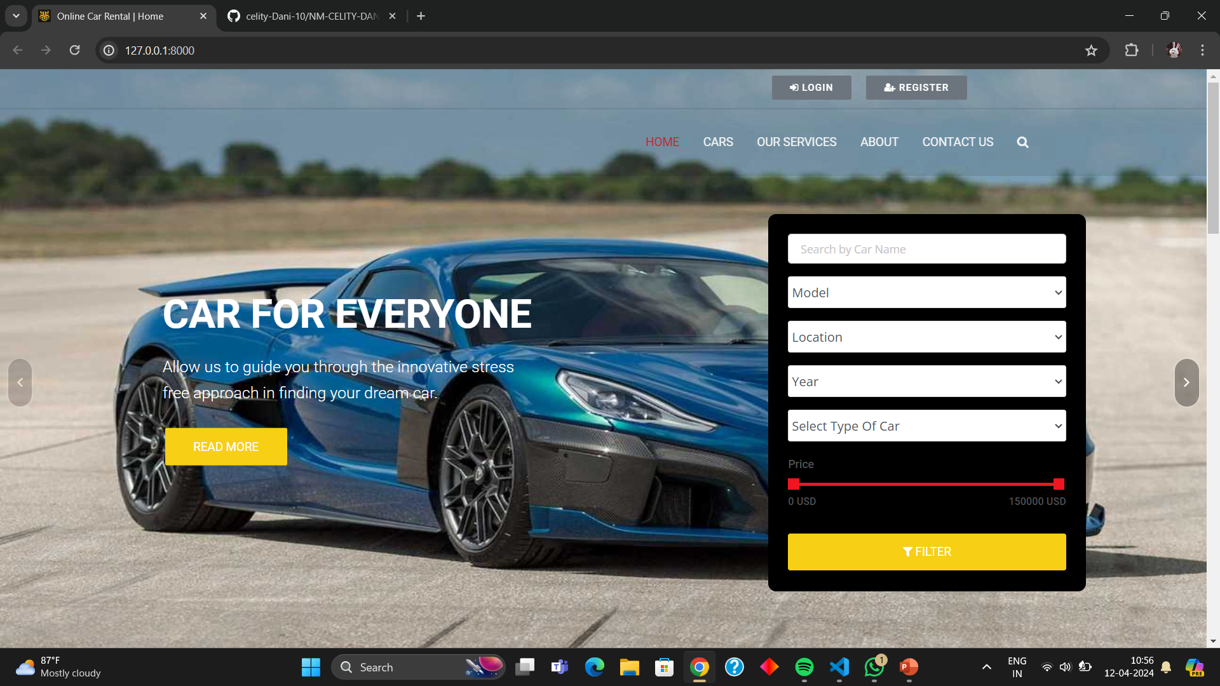
Homepage

Slide 12
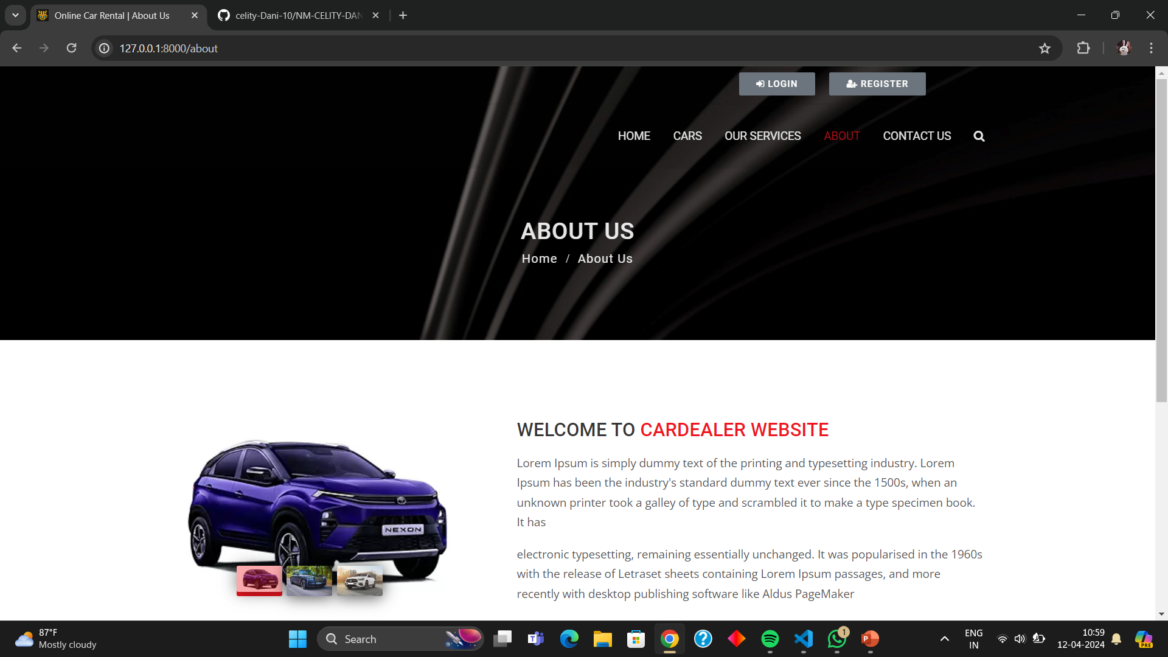
About-Us-Page

Slide 13
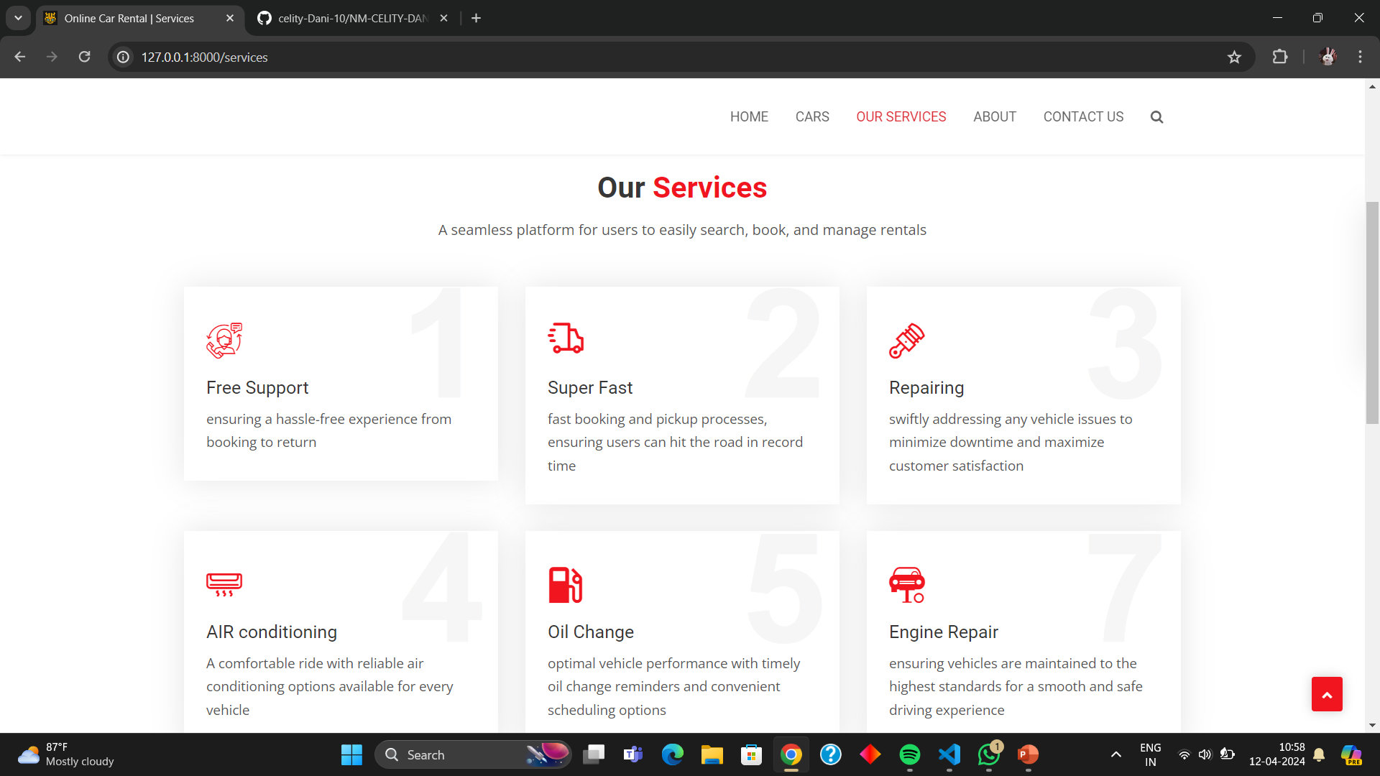
Service-Page

Slide 14
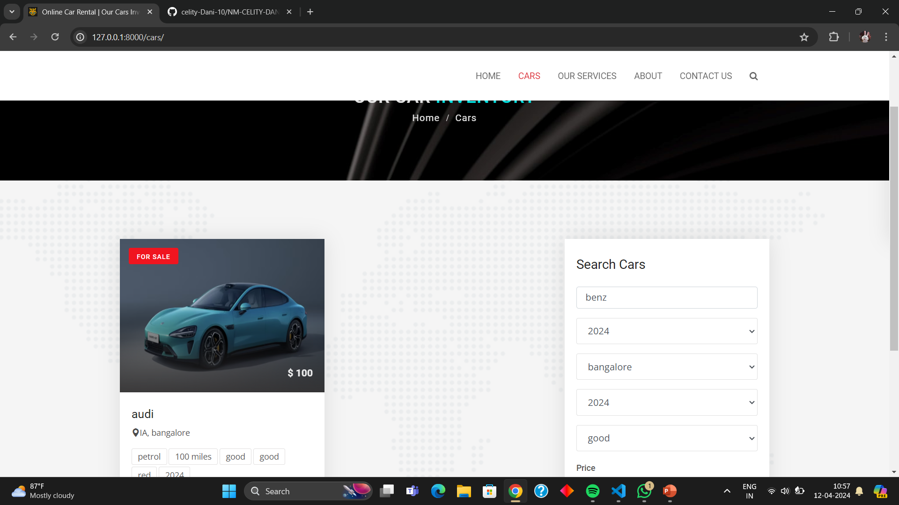
Departments-Page

Slide 15
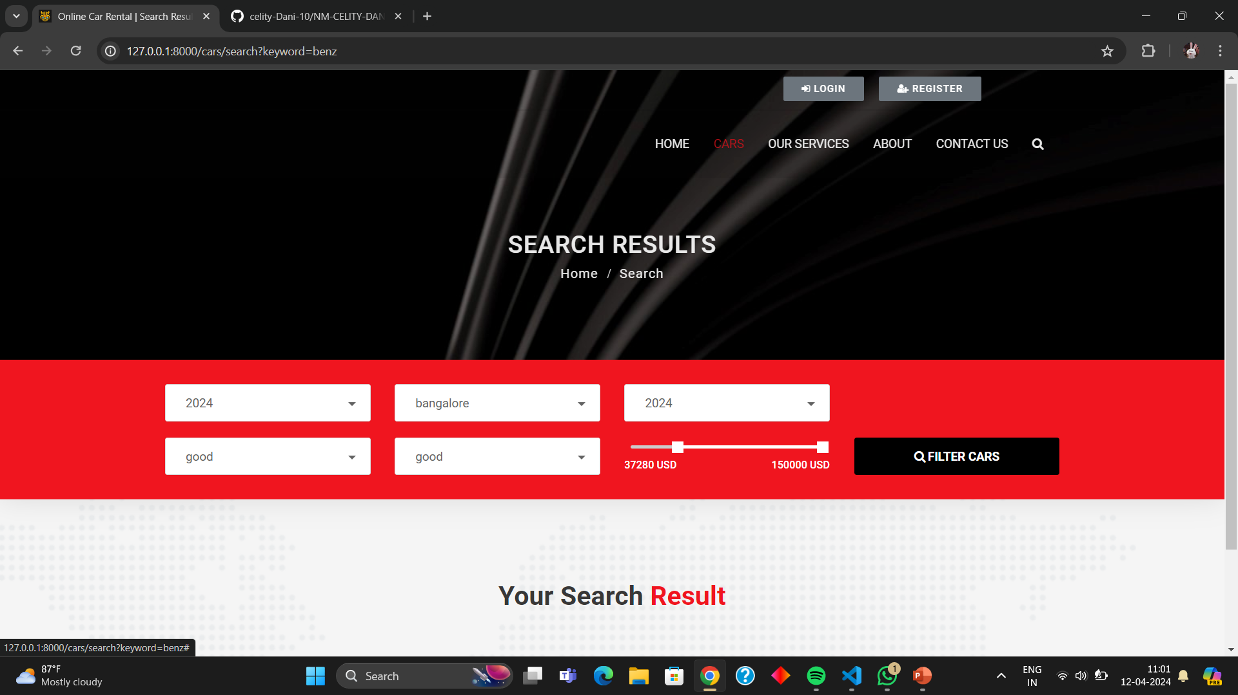
Blog-Page

Slide 16
Future Enhancements:
User Profiles: Implement detailed user profiles where users can manage their personal information, rental history, payment methods, and preferences.
Advanced Search and Filtering: Enhance the search functionality to allow users to filter cars based on criteria such as model year, price range, fuel type, transmission type, etc.
Rating and Reviews: Enable users to rate and review the cars they have rented, providing valuable feedback for both the rental agency and other potential customers.
Integration with Mapping APIs: Integrate mapping APIs to provide users with the ability to locate rental offices easily and get directions to pick up and drop off locations.
Payment Gateway Integration: Integrate popular payment gateways to facilitate secure online payments for reservations and rentals.

Slide 17
Conclusion
In conclusion, leveraging Django framework for a car rental application offers a robust foundation for scalability, security, and flexibility. Future enhancements should focus on user experience optimization, including advanced search, user profiles, and mobile app development.
Integrating real-time availability, payment gateways, and mapping APIs can further streamline operations and improve customer satisfaction.
By continually refining features and embracing emerging technologies, the car rental application can stay competitive and meet evolving user demands effectively.
Source :

Slide 18
Thank You!
Notes:
Thank You !!

